Slide 1
CS 210
Adapter Pattern
October 19th, 2006

Slide 2
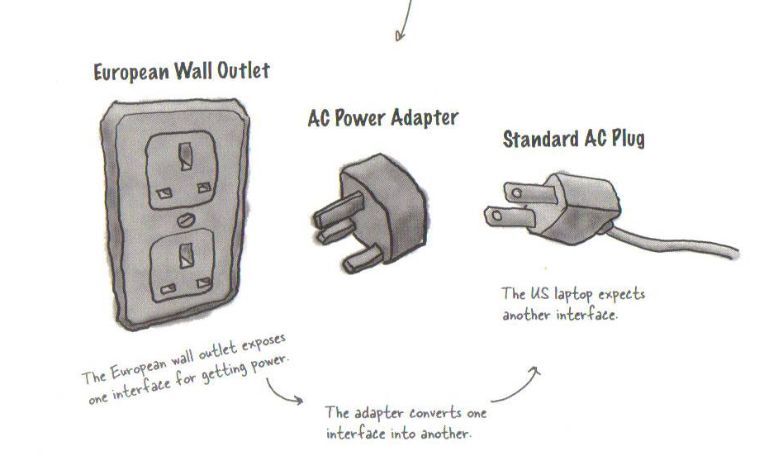
Adapters in real life
Page 236 – Head First Design Patterns

Slide 3
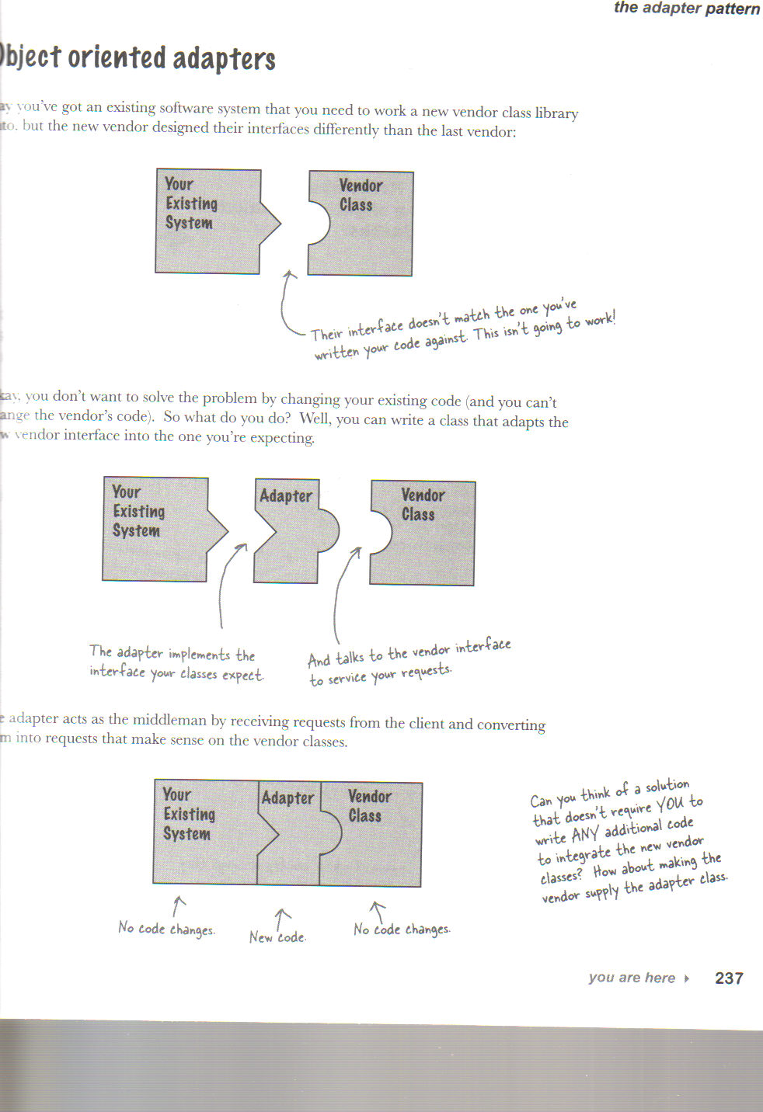
Object-Oriented Adapters
Page 237 Head First Design Patterns

Slide 4
Turkey that wants to be a duck example
public interface Duck {
public void quack();
public void fly();
}

Slide 5
Subclass of a duck – Mallard Duck
public class MallardDuck implements Duck {
public void quack() {
System.out.println("Quack");
}
public void fly() {
System.out.println("I'm flying");
}
}

Slide 6
Turkey Interface
public interface Turkey {
public void gobble();
public void fly();
}

Slide 7
An instance of a turkey
public class WildTurkey implements Turkey {
public void gobble() {
System.out.println("Gobble gobble");
}
public void fly() {
System.out.println("I'm flying a short distance");
}
}

Slide 8
Turkey adapter – that makes a turkey look like a duck
public class TurkeyAdapter implements Duck {
Turkey turkey;
public TurkeyAdapter(Turkey turkey) {
this.turkey = turkey;
}
public void quack() {
turkey.gobble();
}
public void fly() {
for(int i=0; i < 5; i++) {
turkey.fly();
}
}
}

Slide 9
Duck test drive
public class DuckTestDrive {
public static void main(String[] args) {
MallardDuck duck = new MallardDuck();
WildTurkey turkey = new WildTurkey();
Duck turkeyAdapter = new TurkeyAdapter(turkey);
System.out.println("The Turkey says...");
turkey.gobble();
turkey.fly();
System.out.println("\nThe Duck says...");
testDuck(duck);
System.out.println("\nThe TurkeyAdapter says...");
testDuck(turkeyAdapter);
}
static void testDuck(Duck duck) {
duck.quack();
duck.fly();
}
}

Slide 10
Test run – turkey that behaves like a duck
The Turkey says...
Gobble gobble
I'm flying a short distance
The Duck says...
Quack
I'm flying
The TurkeyAdapter says...
Gobble gobble
I'm flying a short distance
I'm flying a short distance
I'm flying a short distance
I'm flying a short distance
I'm flying a short distance

Slide 11
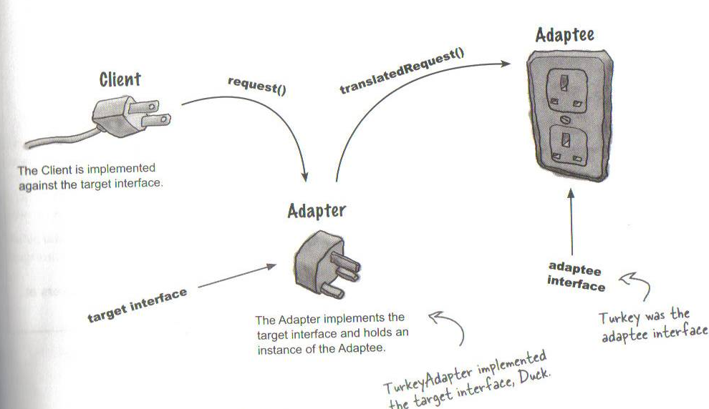
Adapter Pattern explained
Page 241 – Head First Design Patterns

Slide 12
Adapter Pattern defined
The Adapter Pattern converts the interface of a class into another interface the clients expect. Adapter lets classes work together that couldn’t otherwise because of incompatible interfaces.

Slide 13
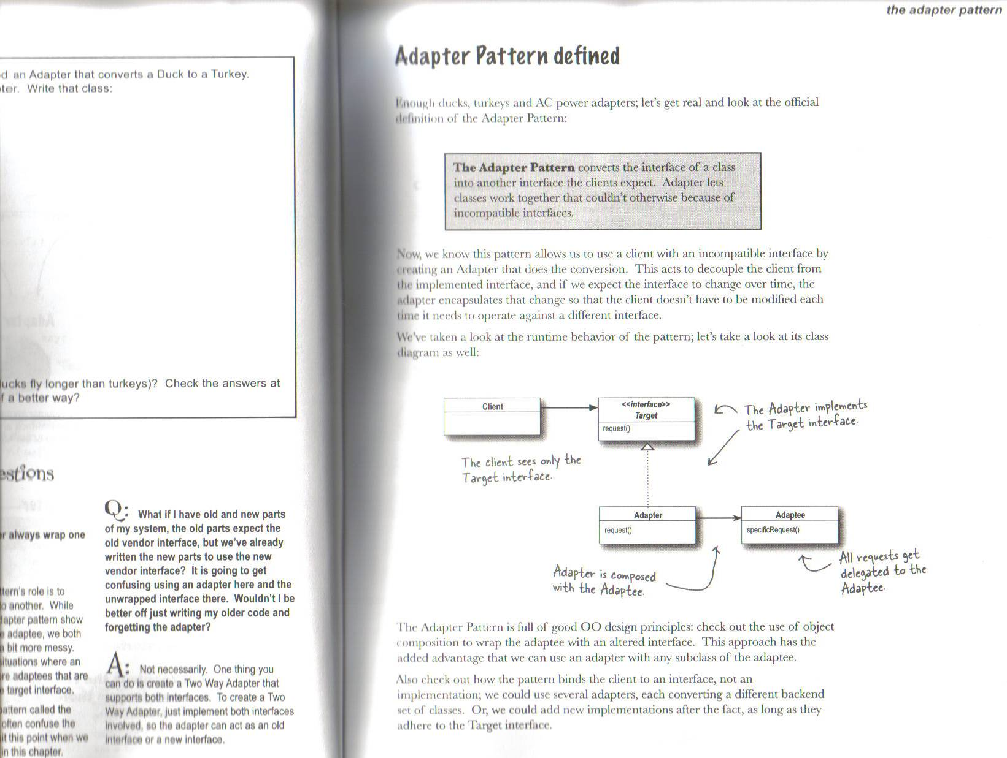
Adapter Pattern
Page 243 – Head First Design Patterns

Slide 14
Façade Pattern
Simplifying complex subsystems

Slide 15
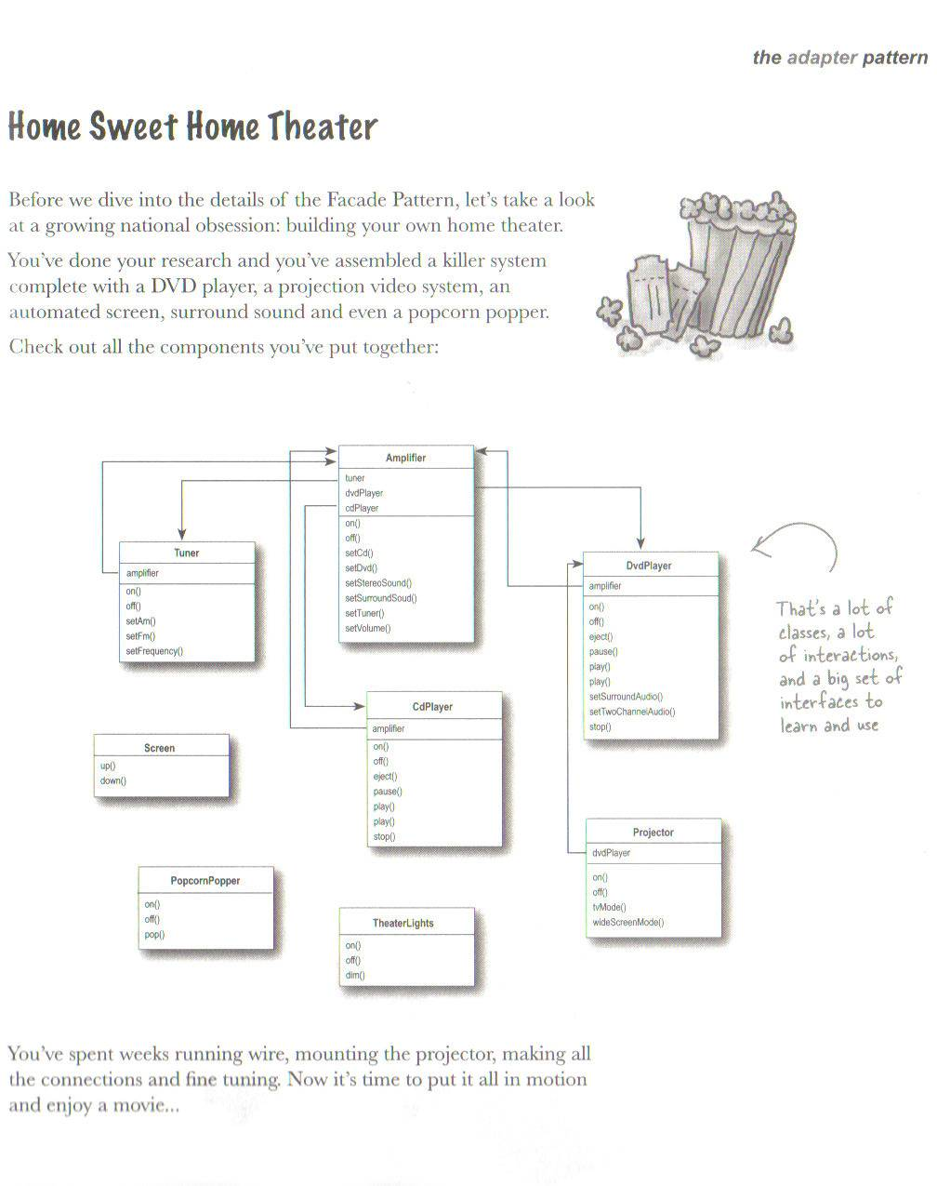
Page 255 – Head First Design Patterns

Slide 16
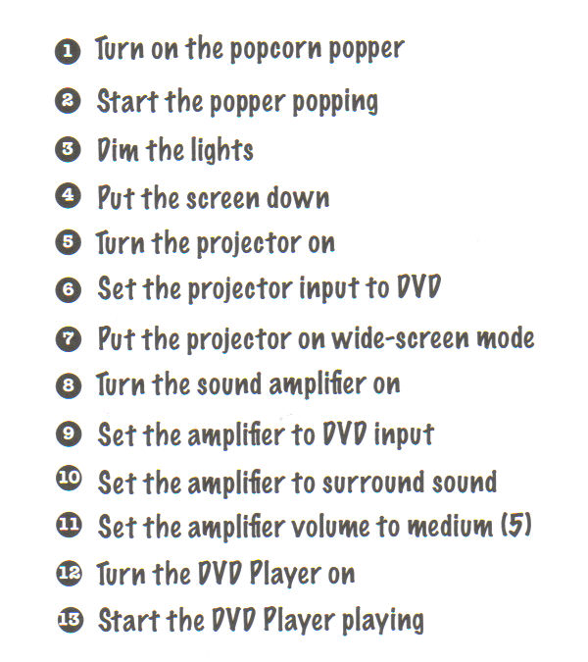
Watching the movie the hard way….
Page 256 – Head First Design Patterns

Slide 17
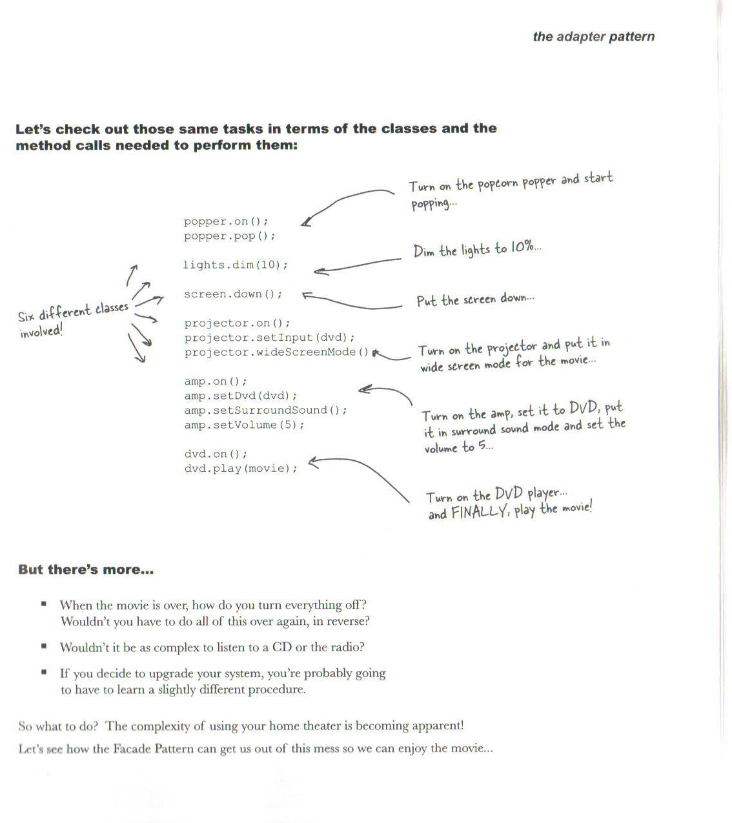
What needs to be done to watch a movie….

Slide 18
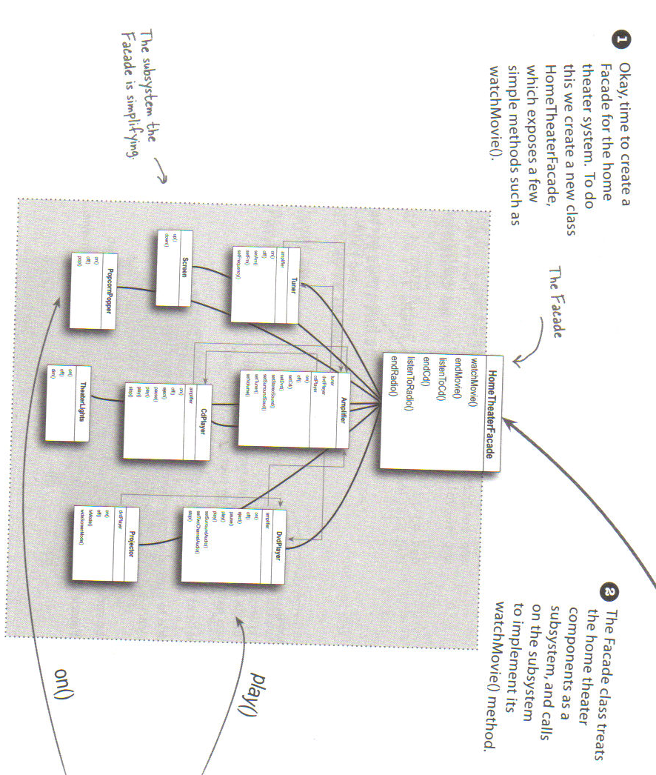

Slide 19
Façade example
Look at Eclipse code for home theater façade

Slide 20
Façade Pattern defined
The Façade Pattern provides a unified interface to a set of interfaces in a subsystem. Façade defines a higher level interface that makes the subsystem easier to use.

Slide 21
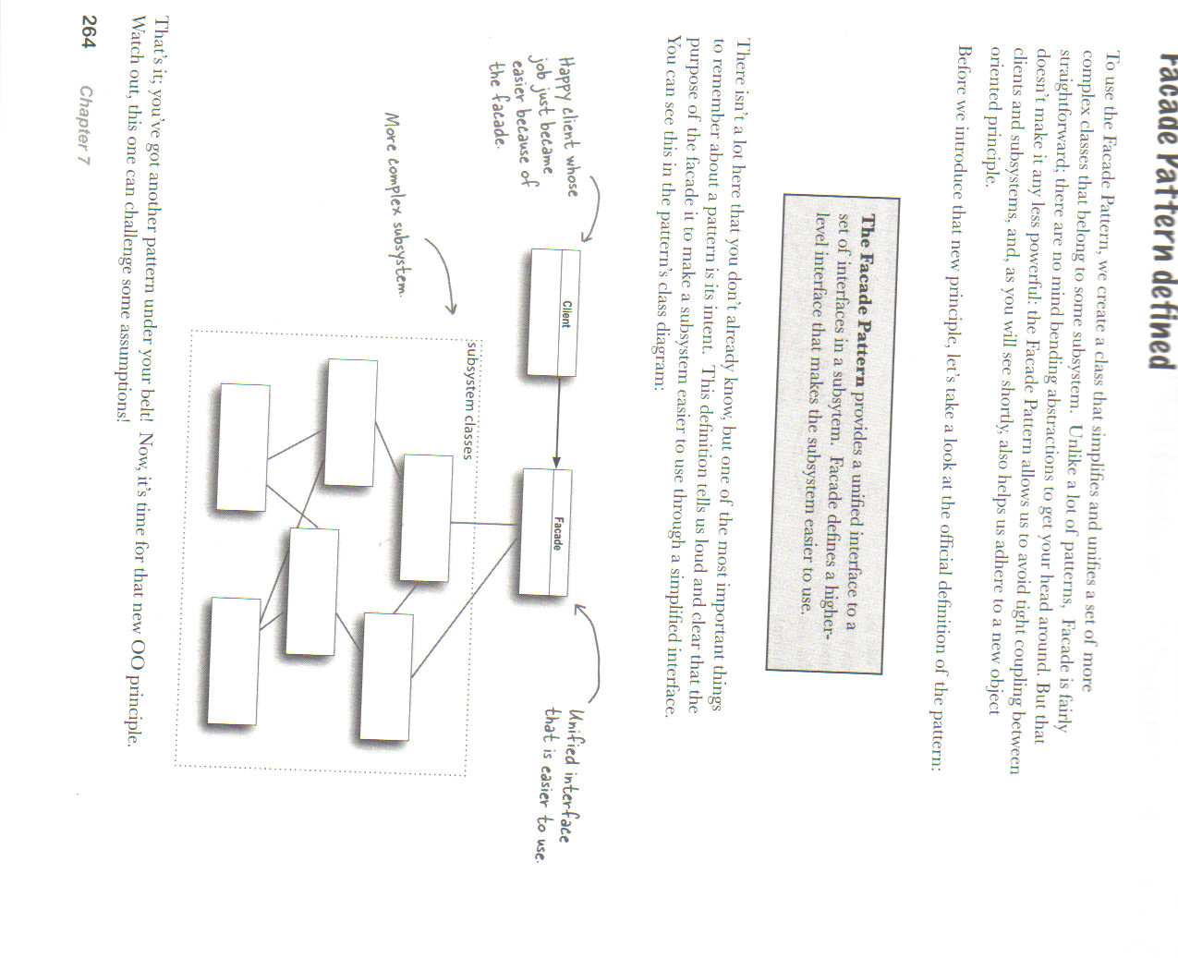
Façade pattern – Class Diagram

Slide 22
Design Principle
Principle of Least Knowledge
talk only to your immediate friends
Basically this says minimize your dependencies

Slide 23
Client
The client only has
one friend – and
that is a good thing
If the subsystem
gets too complicated
One can recursively
apply the same
principle.

Slide 24
A little comparison
Pattern
Intent
Converts one interface
to another
Decorator
Adapter
Doesn’t alter the interface,
But adds responsibility
Facade
Makes an interface simpler

Slide 25
Summary so far..
OO Basics
  Abstraction
  Encapsulation
  Inheritance
  Polymorphism
OO Principles
  Encapsulate what varies
  Favor composition over inheritance
  Program to interfaces not to implementations
  Strive for loosely coupled designs between objects that interact
  Classes should be open for extension but closed for modification.
  Depend on abstracts. Do not depend on concrete classes.
  Only talk to your friends

Slide 26
Summary so far…
OO Patterns
  Strategy Pattern defines a family of algorithms, Encapsulates each one, and makes them interchangeable. Strategy lets the algorithm vary independently from clients that use it.
  Observer Pattern defines a one-to-many dependency between objects so that when one object changes state, all of its dependents are notified and updated automatically.
  Decorator Pattern – attach additional responsibilities to an object dynamically. Decorators provide a flexible alternative for sub-classing for extending functionality
  Abstractor Factory – Provide an interface for creating families of related or dependent objects without specifying their concrete classes.
  Factory Method – Define an interface for creating an object, but let subclasses decide which class to instantiate. Factory method lets a class defer instantiation to the subclasses.
  Command Pattern – Encapsulates a request as an object, thereby letting you parameterize clients with different requests, queue or log requests, and support undoable operations.
  The Adapter Pattern converts the interface of a class into another interface the clients expect. Adapter lets classes work together that couldn’t otherwise because of incompatible interfaces.
  The Façade Pattern provides a unified interface to a set of interfaces in a subsystem. Façade defines a higher level interface that makes the subsystem easier to use.

